Slide 1
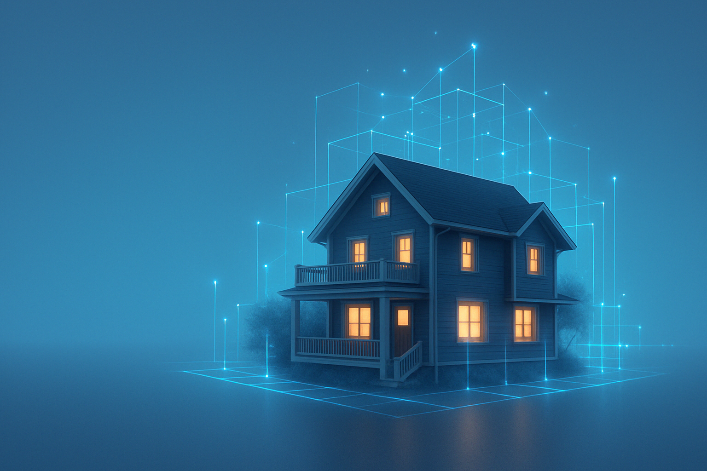
AI HOME ASSISTANT
Presented by Meenakshi Yadav

Slide 2

Agenda
Introduction
Project Structure
Live Demo / Screenshots
Device Integration with the Dashboard
Challenges & Solutions
Future Scope
AGENDA

Slide 3
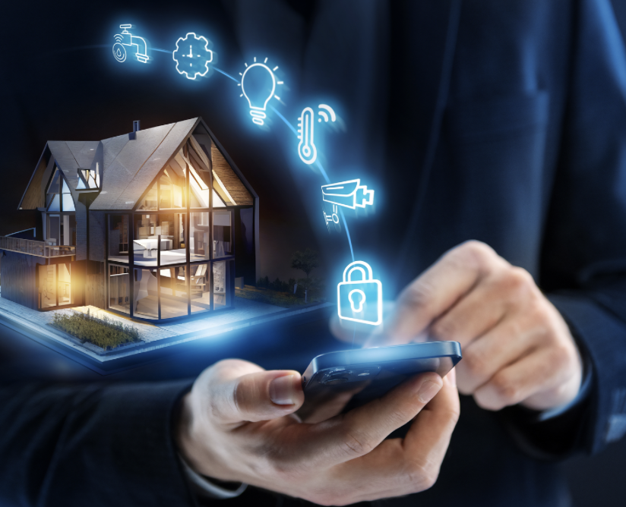
Introduction
The AI Home Assistant Dashboard is a web-based control panel designed to manage and operate smart home appliances from a single, user-friendly interface. It simulates real-world automation with intuitive navigation, emoji-enhanced visuals, and responsive layouts.

Slide 4
To simplify smart home device management
To create a centralized interface for appliances like fans, lights, microwave, AC, and security systems
To explore how frontend design and IoT can work together
Purpose of the Project

Slide 5
Key elements of the ai home assistant

Slide 6
Key Elements
Centralized Dashboard Design
User Friendly Design
Appliance control system
Smooth Navigation
Security and Settings
Voice Navigation
Authenticate Users
Child Lock
Customized Rooms and Appliances

Slide 7
Why is Assistant Important?
Area | Impact on engagement | Source
Centralized Control | Controls all home appliances from one place | Reduces complexity and saves user time
Responsive Design | Seamless experience across mobile, tablet, and desktop | Ensures accessibility on all devices
Appliance Grouping | Simplifies access by room/location | Logical organization improves user flow
Security Settings | Protects access to sensitive features (e.g., door locks) | Adds safety and privacy for the user
Voice Assistant | Enables hands-free control for better accessibility | Ideal for differently-abled and multitasking
Child Lock & Access | Personalization + safe usage by family members | Prevents misuse and gives parental control

Slide 8
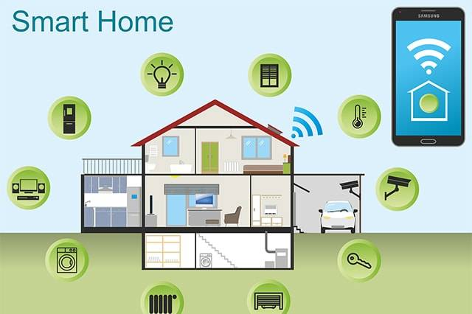
Device Integration With dashboard
Microcontrollers like ESP32 or Raspberry Pi are connected to appliances (e.g., microwave, fans) and act as control units.
The web dashboard sends commands (ON/OFF, speed, temperature) using HTTP requests or MQTT protocol.
Relay modules are used with the microcontrollers to control actual electrical appliances.
All devices communicate over the same Wi-Fi network, enabling real-time control from the browser.
The system can be extended to cloud-based control and voice assistants for hands-free access.

Slide 9


Slide 10
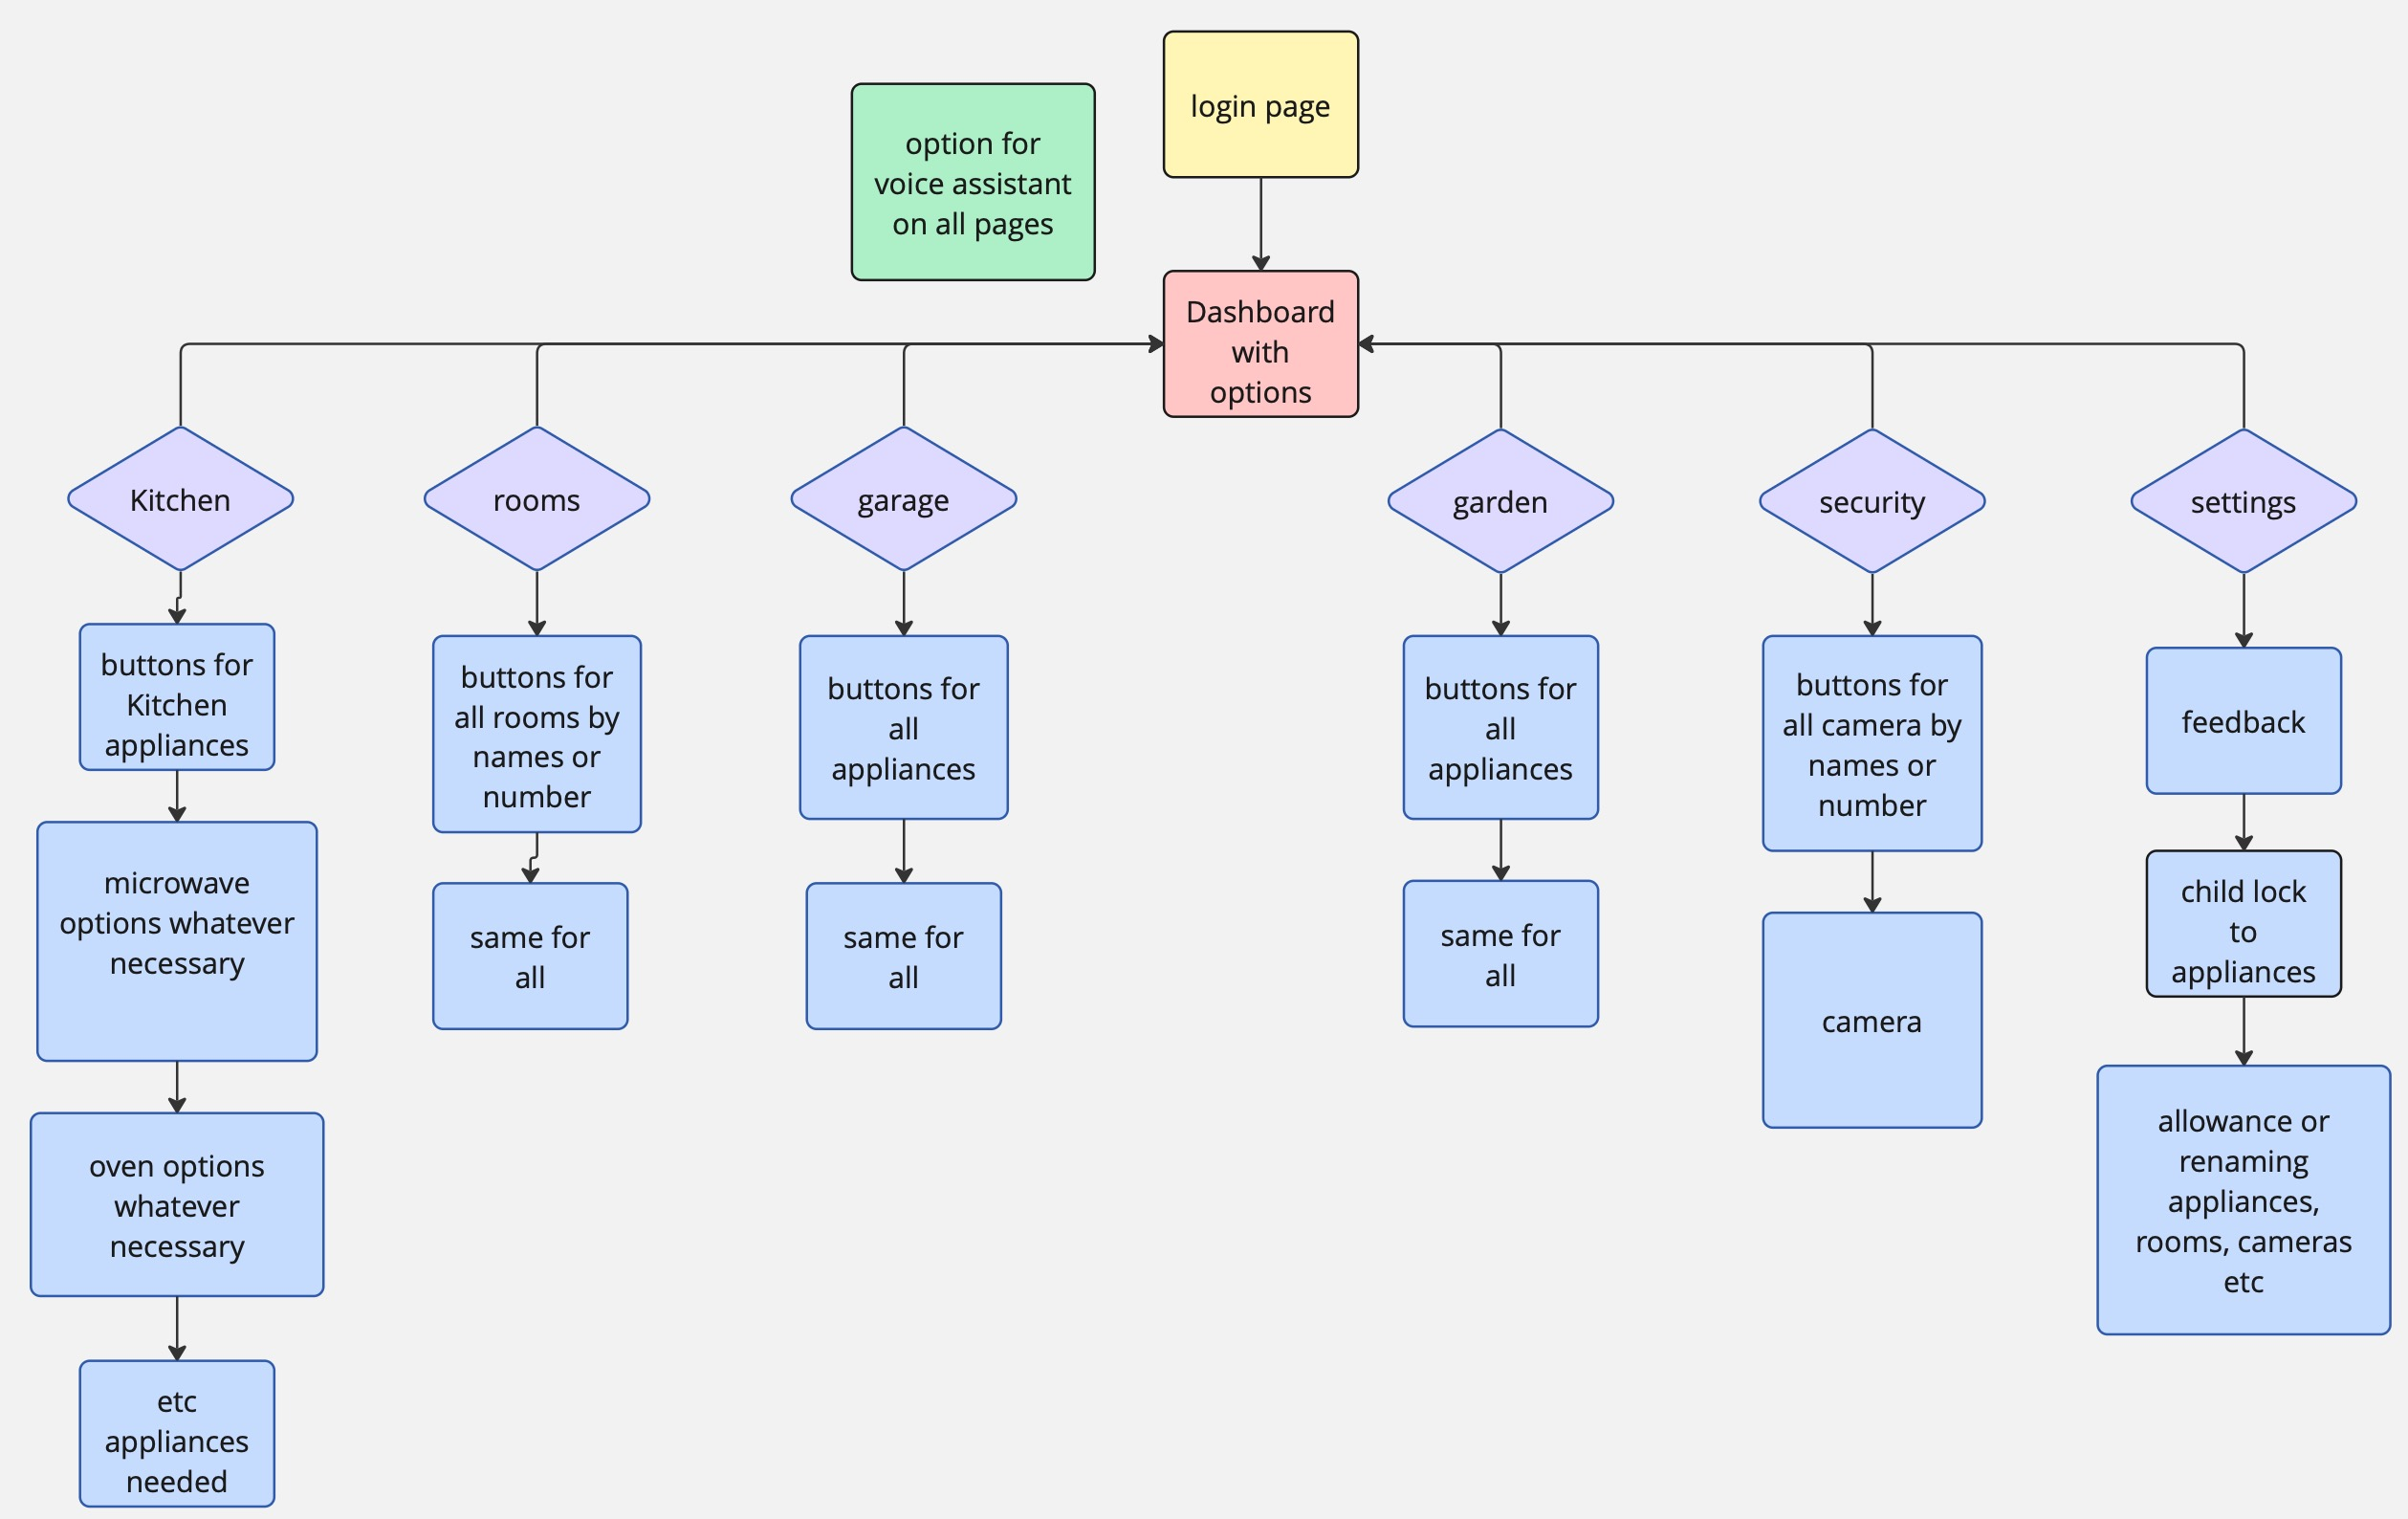
D
A
S
H
B
O
A
R
D
F
L
O
W
C
H
A
R
T

Slide 11
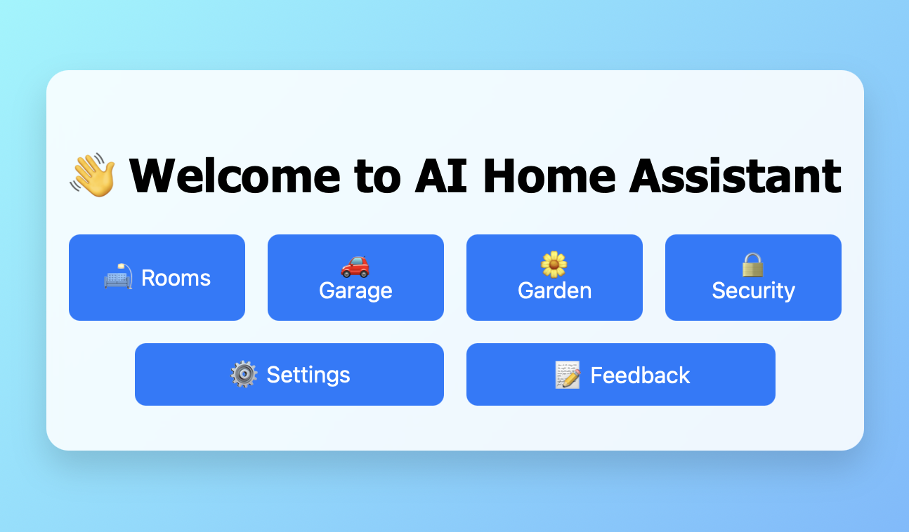
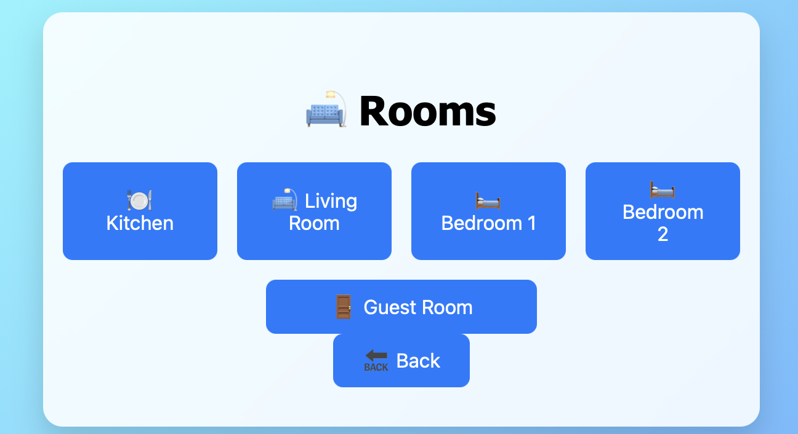
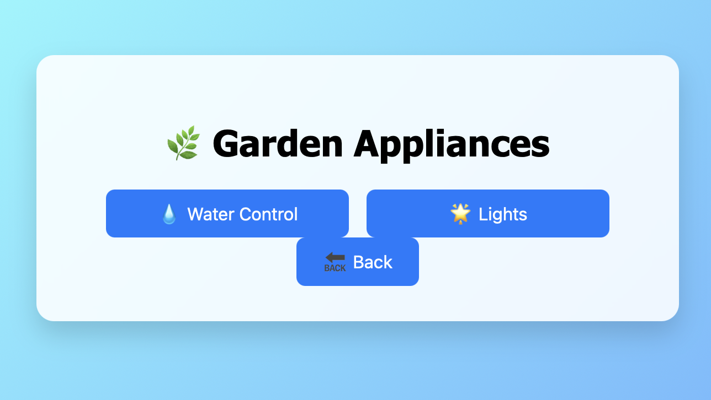
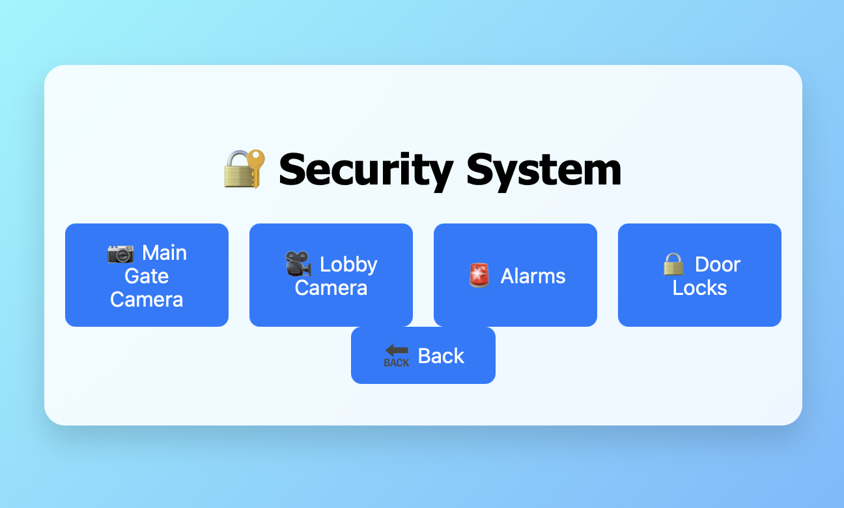

Slide 12
https://github.com/meens-dev/AI-HOME-ASSISTANT
CODE LINK TO AI HOME ASSISTANT DASHBOARD

Slide 13
Challenges faced

Slide 14
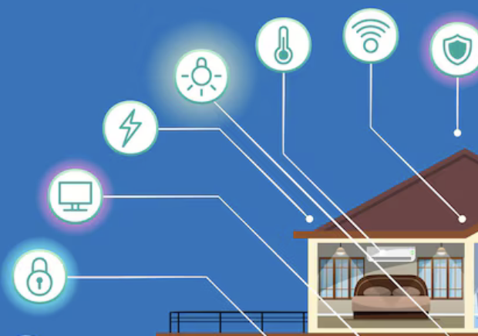
Challenges faced for Effective delivery
Modular Navigation
Designing individual pages for every appliance and linking them without reloading was tricky.
Responsive Design
Making the interface work across desktop, tablet, and mobile was challenging.
User Access & Security
Controlling sensitive features like door locks needs authentication and restrictions.
Performance & Scalability
Managing many appliances across sections risked clutter and slowdowns.

Slide 15
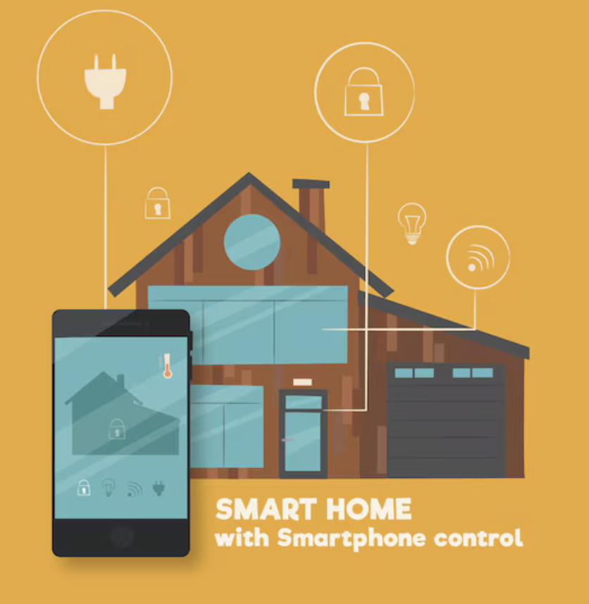
Future SCOPE
We can Integrate Web API for weather, music etc. We can automate things such as According to the location change the settings etc.
Integration with real appliances using ESP32 & Raspberry Pi.

Slide 16
Conclusion
The AI Home Assistant Dashboard simplifies smart home control with a clean, responsive design. It offers centralized appliance management and sets the foundation for future IoT and voice assistant integration.

